Slide 1
TEACHER CUE
CFU
HINT
Scaffolding for students
MAKE THE CONNECTION
Allow students to make the connection

Slide 2
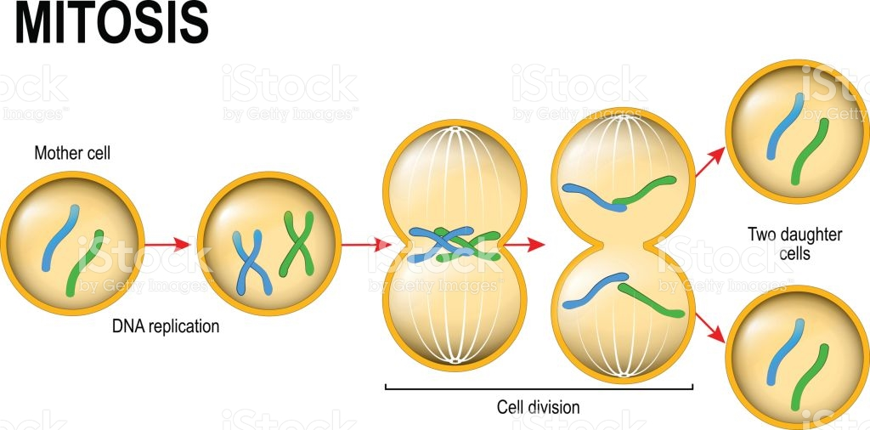
Mitosis occurs during the growth and repair of cells and in asexual reproduction
Are the cells produced in Mitosis genetically identical to each other and the original cell?
How many chromosomes do each of the daughter cells have?
What are the 5 stages of Mitosis and briefly explain what is happening at each stage

Slide 3
I can describe how meiosis relates to DNA
TRACK WITH ME
READ WITH ME
I can give the names of phases of meiosis
I can compare mitosis and meiosis

Slide 4
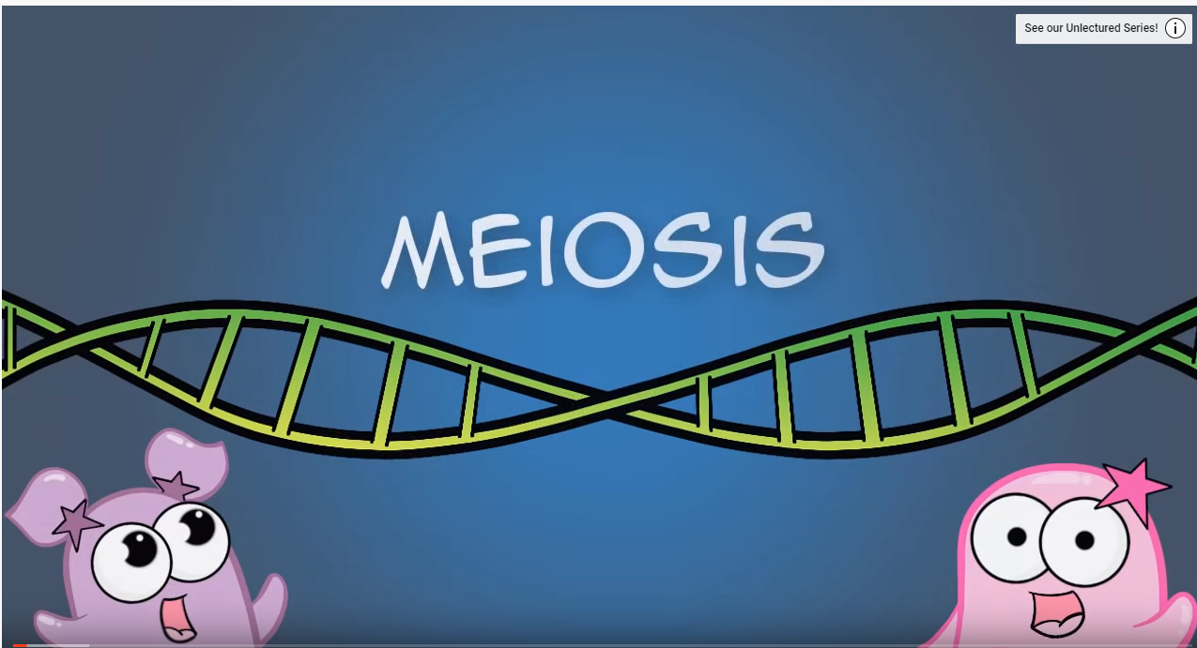
I can describe how meiosis relates to DNA
Meiosis
Occurs only in reproductive cells (sperm and egg cells) – known as haploid cells (23 chromosomes)
IPMAT-MAT (has a 2nd division to create 4 cells)
Creates variety! Q. Who has a sibling?
Haploid (sex cells) = 23 chromosomes
Diploid (all other cells) = 46 chromosomes

Slide 5
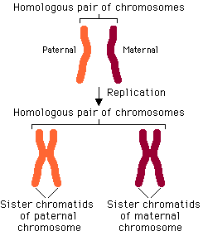
I can describe how meiosis relates to DNA

Slide 6
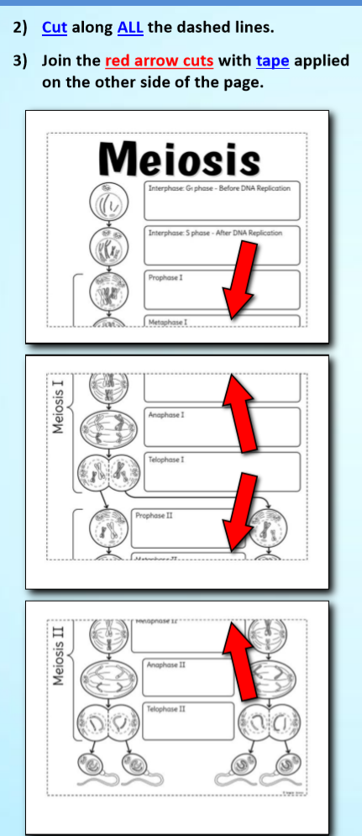
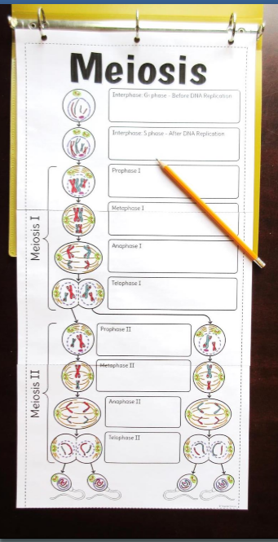
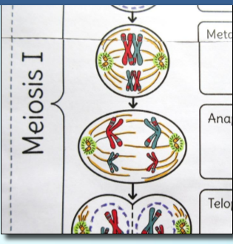
LISTEN CAREFULLY TO MS SILVA FOR YOUR INSTRUCTIONS

Slide 7
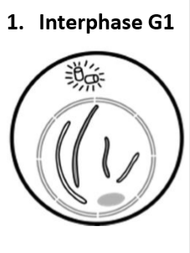
I can describe how meiosis relates to DNA
This is the part of the cell cycle where the cell is increasing in size.
It contains one copy of each chromosome in this stage
Your diagram has two pairs of homologous chromosomes (one long pair and one short pair)
Designate one colour the paternal homologues (e.g. the white) and the other colour the maternal homologues (e.g. the grey)

Slide 8
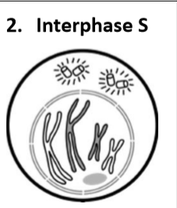
I can describe how meiosis relates to DNA
DNA is replicated to create two copies of each chromosome
Identical copies are attached to one another (at a midpoint called the centromere)

Slide 9
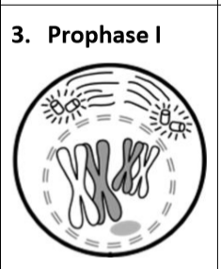
I can describe how meiosis relates to DNA
Beginning of Meiosis 1 – the first meiotic division
Synapsis occurs as the chromosomes migrate towards one another and pair up
The paternal (father) and maternal (mother) homologues exchange DNA and this is called crossing over
The crossing over is random and results in random genetic variation in the resulting sex cells (egg/sperm)

Slide 10
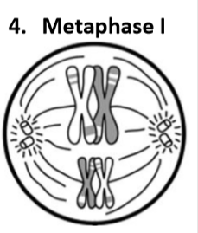
I can describe how meiosis relates to DNA
The chromosomes align at the equatorial plate (the middle).
Crossing over can happen again.
Notice they are crossed over (the bands!)

Slide 11
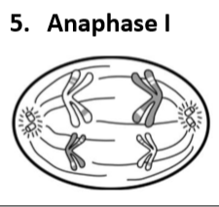
I can describe how meiosis relates to DNA
Chromosomes separate to opposite poles

Slide 12
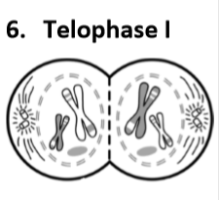
I can describe how meiosis relates to DNA
Telophase 1 signals end of first meiotic division.
The DNA does not replicate again before entering Meiosis II

Slide 13
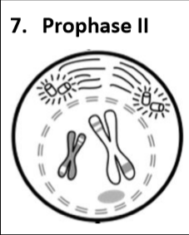
I can describe how meiosis relates to DNA
The beginning of Meiosis II – the second meiotic division.
This is very similar to mitosis – except the resulting daughter cells are non-identical in meiosis (not ‘clones’ like in mitosis)
Cell thickens and membrane begins to dissolve

Slide 14
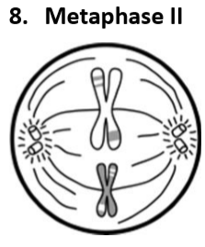
I can describe how meiosis relates to DNA
Chromosomes move to equator/middle and line up.
Random genetic variation occurs again as the orientation at the poles is random – so when they separate – its random which chromatid ends up at which pole!

Slide 15
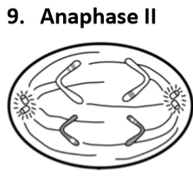
I can describe how meiosis relates to DNA
The chromatids move to opposite poles

Slide 16
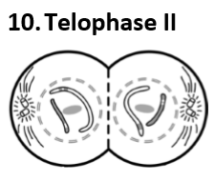
I can describe how meiosis relates to DNA
Telophase II signals the end of the second meiotic division.
If meiosis occurs as a part of spermatogenesis, then 4 sperm are created at the end of meiosis (as seen in your foldable)
If meiosis occurs as a part of oogenesis, then 1 egg and 3 polar bodies are created at the end of meiosis

Slide 17
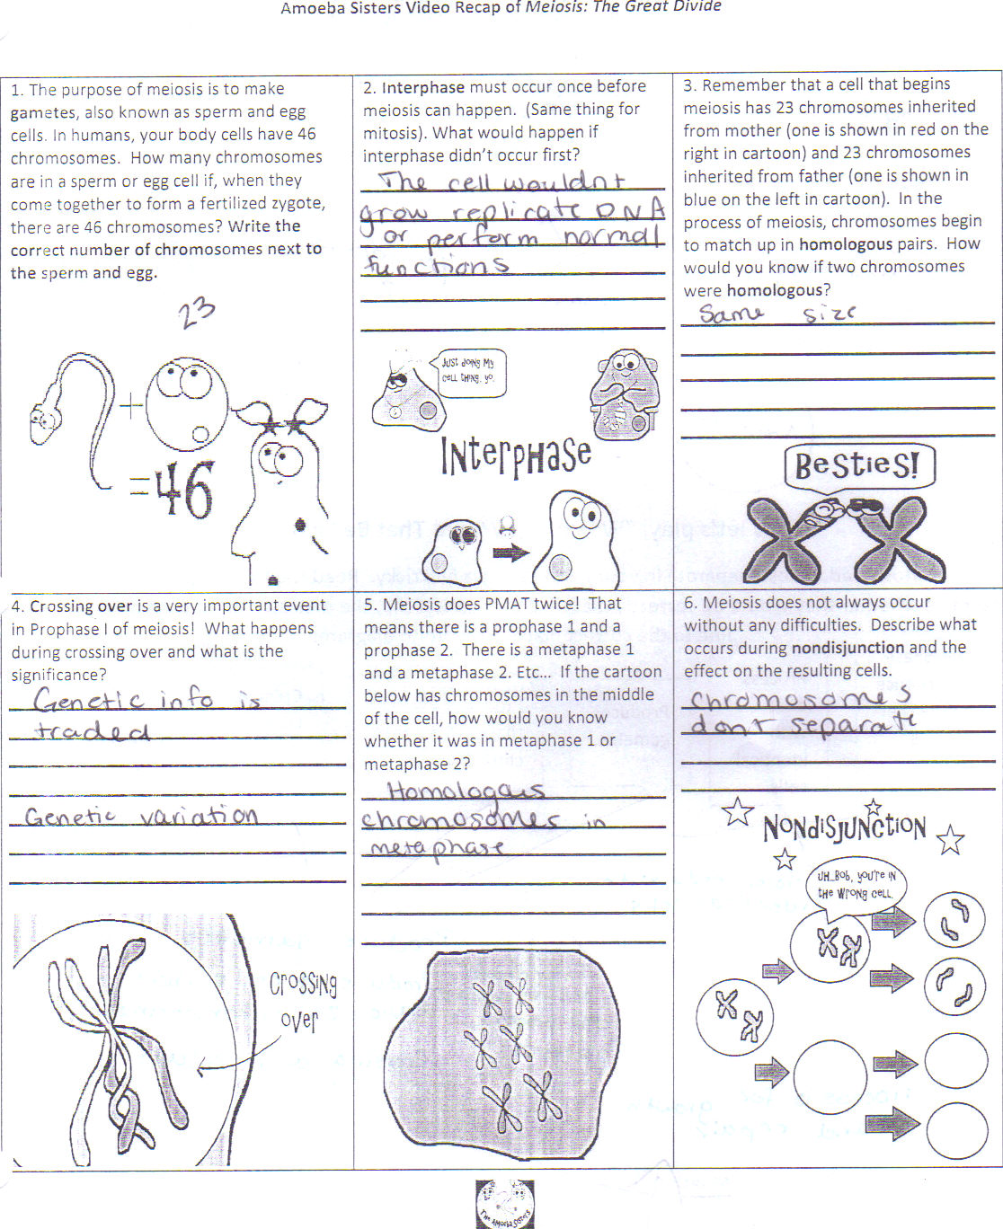

Slide 18
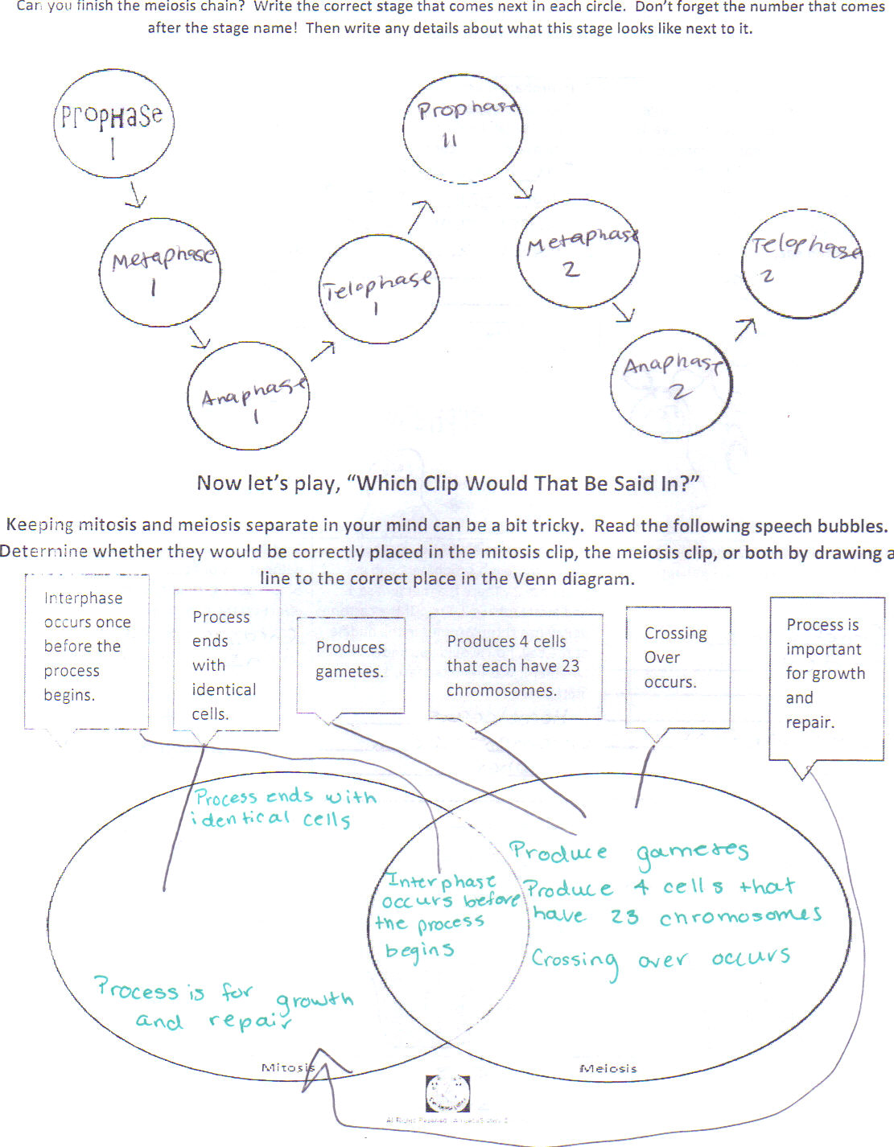

Slide 19
I can describe how meiosis relates to DNA
TRACK WITH ME
READ WITH ME
I can give the names of phases of meiosis
I can compare mitosis and meiosis

